Slide 1
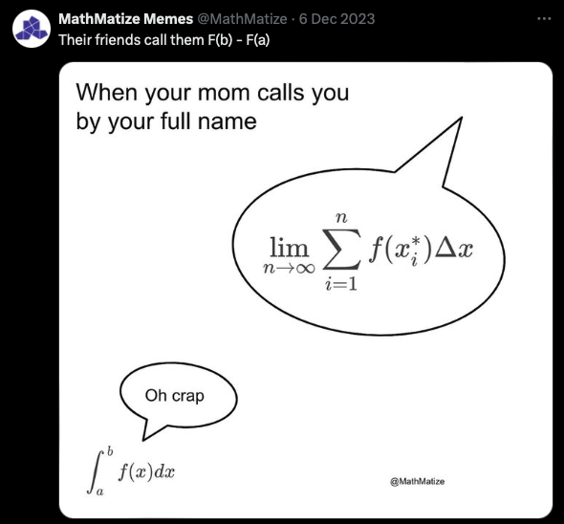
Computer Graphics Rendering
Lecture 12: Monte Carlo Integration
Kartic Subr

Slide 2
Recap

Slide 3
Using randomness
Georges-Louis Leclerc, Comte de Buffon
(1707-1788)

Slide 4
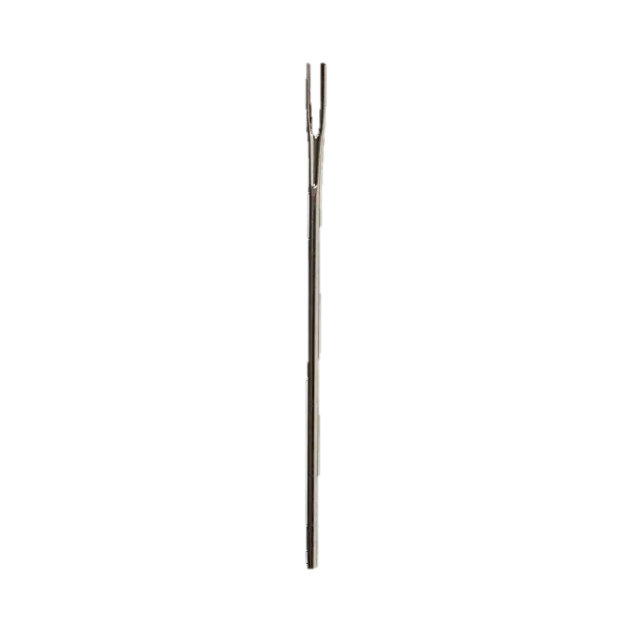

Using randomness
Suppose we have a floor made of parallel strips of wood, each the same width, and we drop a needle onto the floor. What is the probability that the needle will lie across a line between two strips?
t
$ℓ$< t
Georges-Louis Leclerc, Comte de Buffon
(1707-1788)

Slide 5
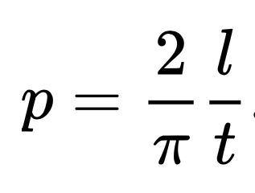
Using randomness
https://people.orie.cornell.edu/sbanerjee/courses/orie4580f20/
http://dmcpress.org/cm/buffon/experiment.html

Slide 6

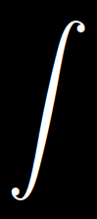
Why all the fuss?
Shiny ball in motion
Shiny ball, out of focus
…
pixel
multi-dim integral

Slide 7
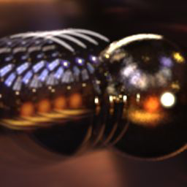

Estimating integrals, at the core of rendering!
Shiny ball, out of focus
…
pixel
multi-dim integral
Fixed steps in time
Random samples in time

Slide 8
Random variables: refresher

Slide 9
Continuous 1D distribution

Slide 10

Expectation, probability distribution, probability

Slide 11
Numerical integration using random samples

Slide 12
Numerical integration using random samples

Slide 13
Area of a circle

Slide 14
From integrating circles to general functions

Slide 15
Formally …

Slide 16
Importance sampling: intuition

